Slide 1

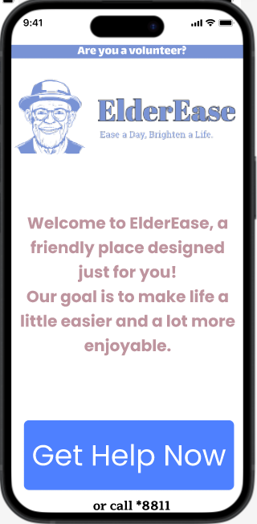
ElderEase
EASE A DAY, BRIGHTEN A LIFE
Dina Kakiashvili
Natalie Nanikashvili

Slide 2
The problem
Older individuals often face numerous challenges that significantly affect their daily routines.
The challenges can be in many aspects, such as:
Physical - Technical Assistance: Household chores, Moving assistance, Furniture assembly, Delivery services, Personal assistance
Social
Medical
Technology
emergency situation
There is a desperate need for a solution that fits those challenges.
What seems simple to us can be a complex task for them

Slide 3
What is elderease?
An innovative solution in the form of an application.
Aims to bridge the gap between older individuals and compassionate volunteers.
Aims to enhance the overall well-being of older individuals
Uses different algorithms to connect between elders and volunteers.
A combination of “TaskRabbit” and “Yedidim”.

Slide 4
MOTIVATION
Improve Quality of Life
Build Relationships (Social)
Increase Accessibility to Support
Provide Reliable Help
Facilitate Quick Response
Reduce Loneliness

Slide 5
Existing platforms
Cups of Tea | Nextdoor | TaskRabbit | ELDEREASE | Feature
 |  | ✔ | ✔ | Personalized Volunteer Profiles
 |  |  | ✔ | Targeted for Seniors
 | ✔ | ✔ | ✔ | Localized Service Matching
 |  | ✔ | ✔ | User Verification
 |  |  | ✔ | Accessibility for Older Adults
✔ |  | ✔ | ✔ | Direct Communication
 |  |  | ✔ | Managed by Administrators
 |  | ✔ | ✔ | Skills Matching
 |  |  | ✔ | Comprehensive Telephone Support
✔ | ✔ | ✔ | ✔ | App and Phone Access
 |  |  | ✔ | Easy-to-Use Interface
 |  |  | ✔ | Management Company Oversight
 |  |  | ✔ | Volunteer Orientation and Training
 | ✔ |  | ✔ | Community-Based Volunteer Engagement

Slide 6
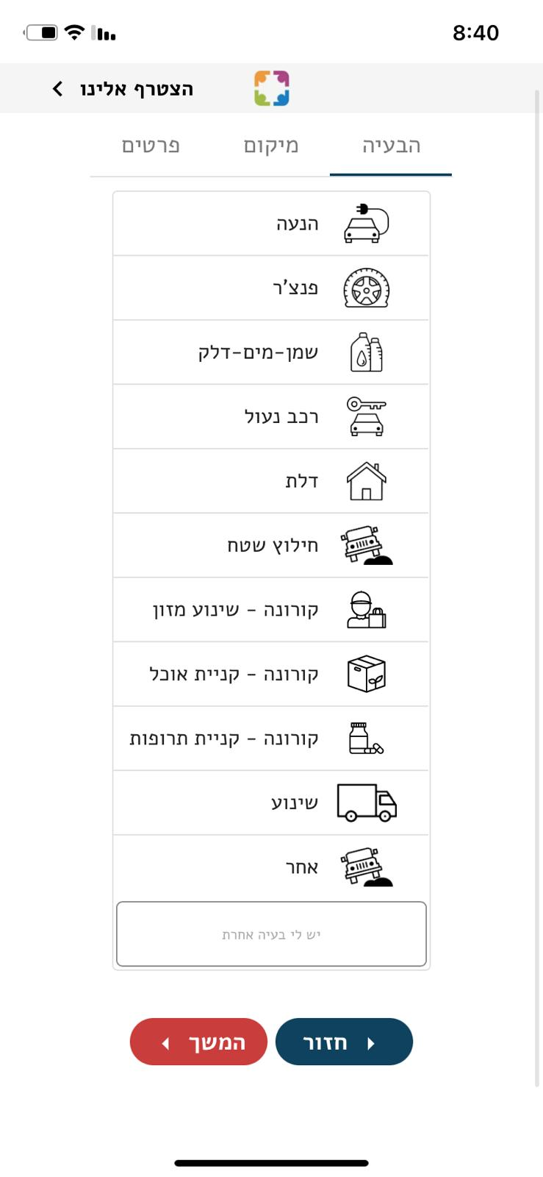
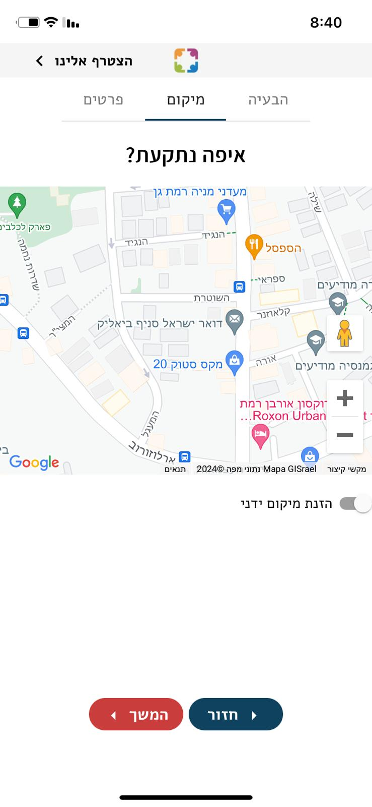
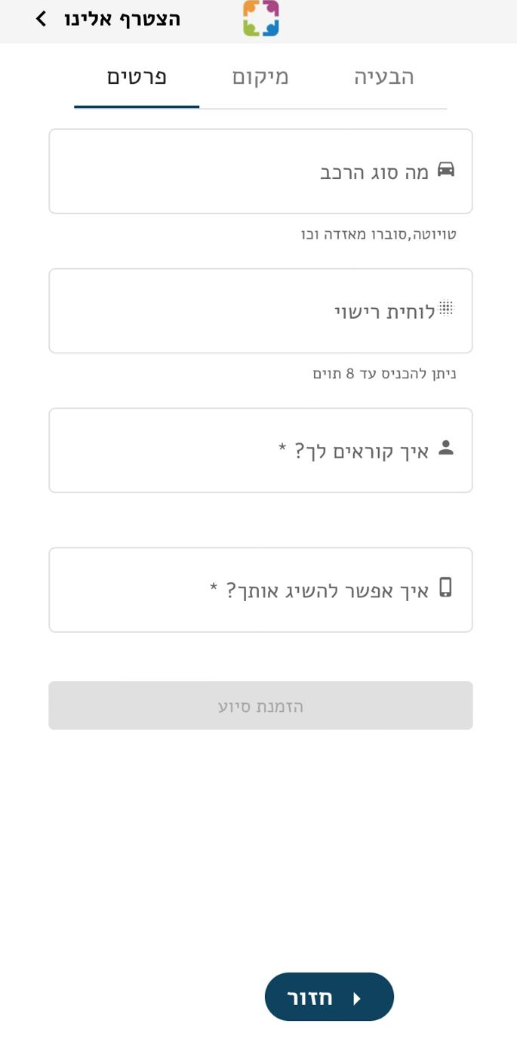
We were based on Yedidim application

Slide 7
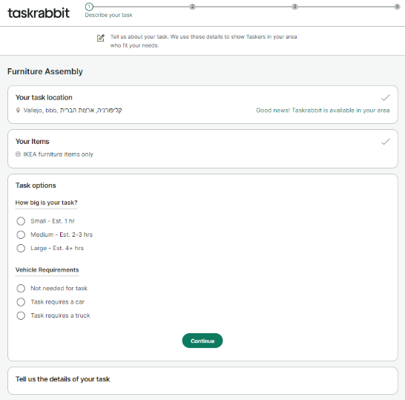
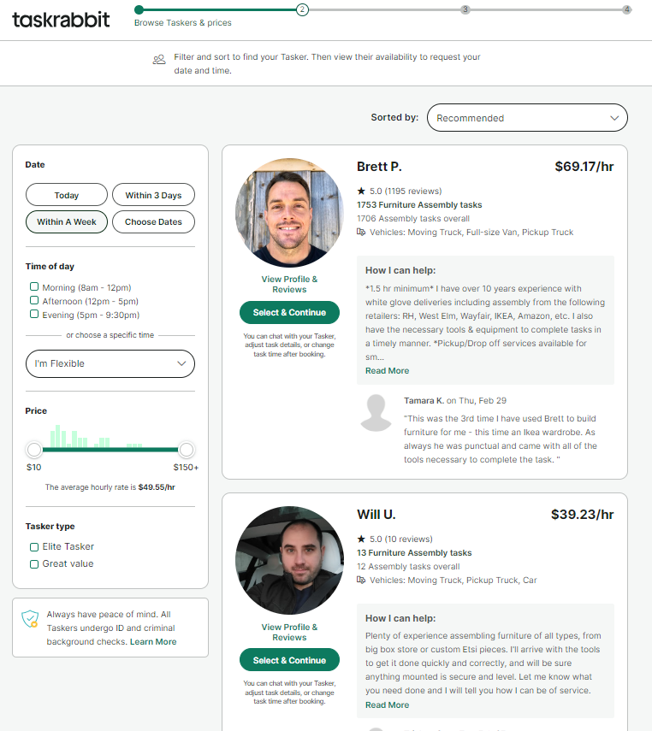
We were based on TaskRabbit

Slide 8
The development process
Communication
Planning
Estimating
Project Initiation
Modeling
matching expectations
Code
Implementation
Deployment
Requirements Gathering
Scheduling
Researching
Design
USECASE, ACTIVITY
Corrections and changes
feedback

Slide 9
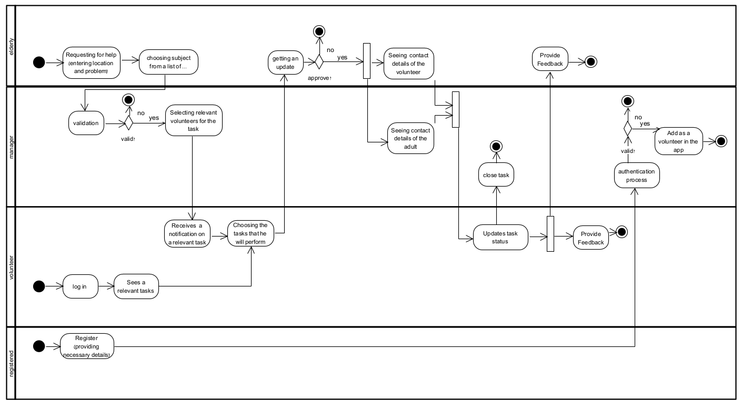
Activity diagram

Slide 10
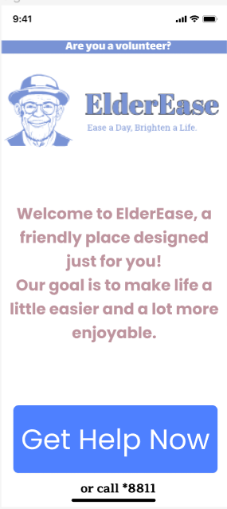
Elderease FLOW- elder’s side
A very elegant and not too detailed screen.
When clicking “Get help now” one of two things can happen
Filling in data – only on the first time
Performing an authentication process
If it’s done properly – the elder will be able to enter his account.
In the account the elder will be able to open a new help request which will be transmitted to the manager.

Slide 11
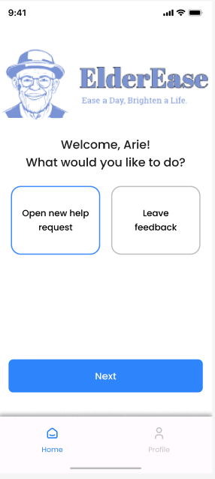
Elderease FLOW- elder’s side
The main screen for the elders.
Again, elegant and simple.
In this screen the elders will be able to choose the operation they would like to do.
There are two types of operations:
Open new requests
Leave feedback about volunteers

Slide 12
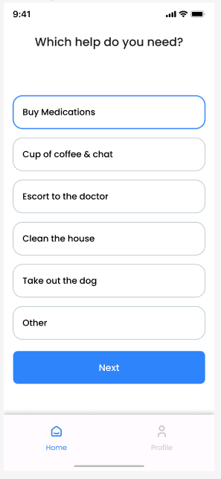
Elderease FLOW- elder’s side
The elder can choose from a list of activities.
The elder will click “Next” to add further information, such as address, contact phone, etc..

Slide 13
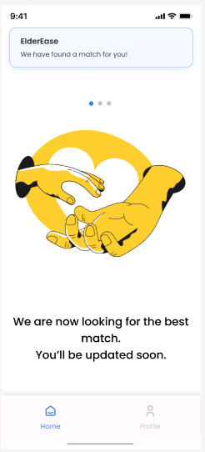
Elderease FLOW- elder’s side
Now the help request is transferred to the manager and the manager will assign it to the relevant volunteers, according to location and Interests of the volunteer.
As soon as a volunteer is found – the elder will get a notification about that.
The screen sums up the process for the elder and makes it very clear for him that the process in his side ended.

Slide 14
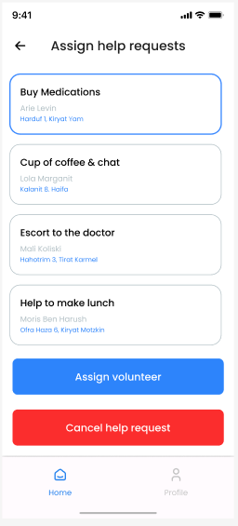
Elderease FLOW- Manager’s side
The manager calls the elder and verifies that he opened the help request
If so, the manager clicks assign volunteer. Otherwise, cancels the help request.

Slide 15
Matching algorithm
Interests
Distance
A grade of 0-100
A grade of 0-100
Total grade = 0.3 * interests + 0.7 * distance
Volunteers with total grade > 80 will be matched to the help request.

Slide 16
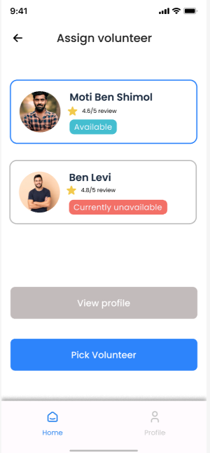
Elderease FLOW- Manager’s side
The application provides list of relevant volunteers according to location and interests.
The manager can assign few volunteers to the same help request. And the volunteers will get a notification.

Slide 17
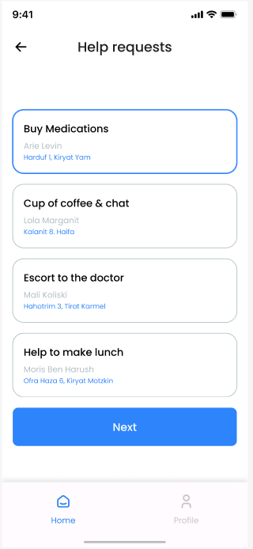
Elderease FLOW- Volunteer’s side
The volunteer can see all the help requests assigned to him by the manager.
The volunteer can choose the help request that is most relevant for him.
After that a notification will be sent to the elder in order to confirm the volunteer.

Slide 18
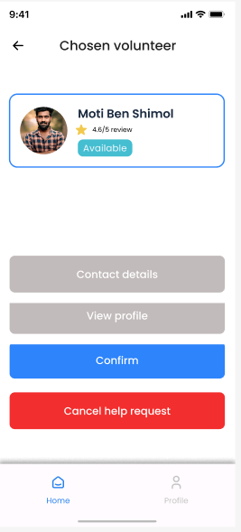
Elderease FLOW- Elder’s side
Confirmation of the volunteer
The elder is able to view the volunteer’s profile and contact details.
The elder is able to cancel the help request.

Slide 19
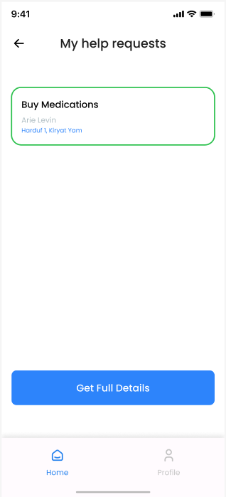
Elderease FLOW- Volunteer’s side
When the elder confirms the volunteer, the help request will be finally assigned to him, and he will be able to get the full details

Slide 20
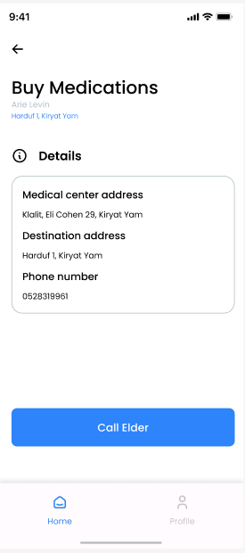
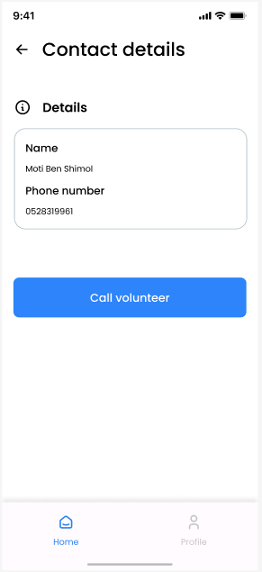
Elderease FLOW- Volunteer’s & ELDER’S side
Both the volunteer and elder can see details about each other and contact with each other.

Slide 21
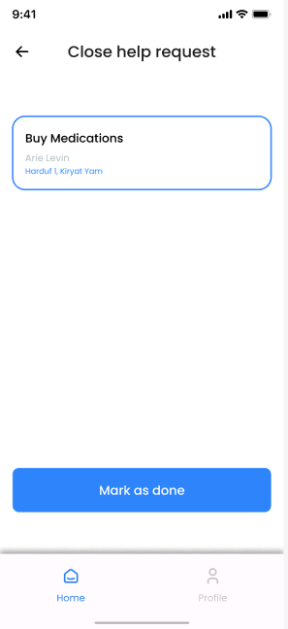
Elderease FLOW-
When the volunteer is done helping the elder, he will mark the help request as done and close it.
The manager will do the same and close the help request finally.

Slide 22
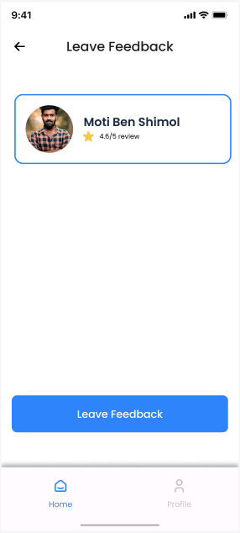
Elderease FLOW-
After closing the help request - both the elder and the manager can leave feedback about the volunteer.

Slide 23
challenges
Working with volunteers can sometimes be challenging.
Choosing volunteers
The need for rating volunteers
Will they get paid in some way?
Constructing a team that will lead this project to success.
A team that will recruit the volunteers
Will they get paid?

Slide 24



Technologies
Backend Frontend DB

Slide 25
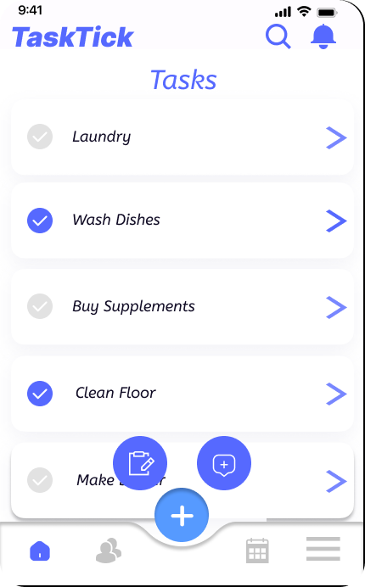
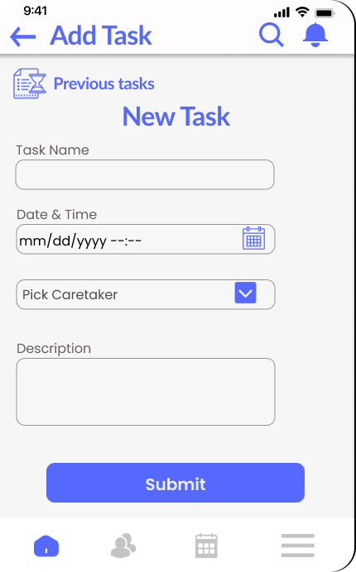
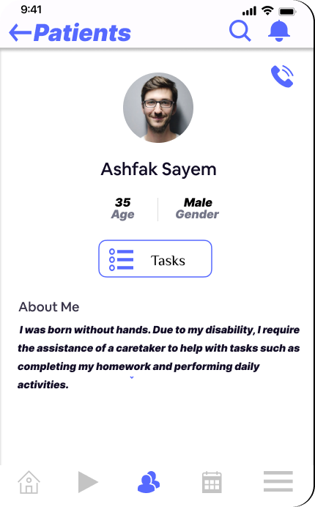
Right Before we end…
Where did we get this idea from?

Slide 26
Thank you for listening!

